Slide 1
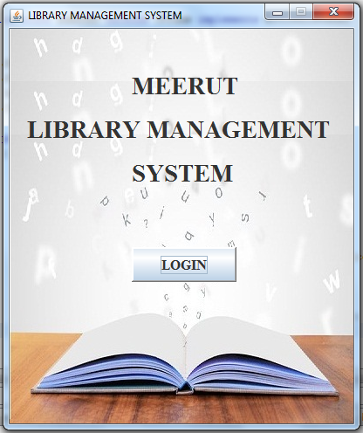

JAVA
PRESENTATION

Slide 2

ABSTRACT
This project has been made in JAVA language (FRONTEND) and SQL (BACKEND). Library management system project is just a Graphical User Interface application with graphics and button.
The implementation of LIBRARY MANAGEMENT starts with entering and updating records like book details, member details.
Any further transfer like book issue, book return will automatically update the current books.
It will track on the how many books are in library.

Slide 3

PURPOSE
The purpose of this project is provide a friendly environment to maintain the details of books, librarian and members.
The main purpose of this project is to maintain easy circulation system using computers and to provide different reports.
This project is basically updating the manual library system into a software based application so that the users can know the details of their account availability of books etc.

Slide 4

NEED FOR A NEW SYSTEM
Time consuming.
Searching challenging task.
To calculate penalty for late coming.
Generating reports is complex.
Maintaining register is complex.

Slide 5

Objectives Of The Project
Basic Objectives
More Accuracy
Speed improvement
Other Objectives
The System will handle the maintenance of data.
It handle entire transaction of book registration till issue of the book.
Book wise search can be performed.

Slide 6

Start
QUICK OVERVIEW
New User
Login
Forget Password
Book
Member
Book Entries
New Member
Book Issue
Delete
Book Return
Menu
Report
Librarian
Book List
Change Password
Member List
Quit
Change User
About
Close
About System

Slide 7

About actionPerformed(ActionEvent)
JButton
SAVE
It save value on database.
NEW
It generate new ID.
DELETE
It delete record.
UPDATE
It update the already save value on database.
RESET
It clear value from the box.
SEARCH
On the basis of ID, we can search about it.
JComboBox
On the basis of selected index, the value of other box changed.

Slide 8
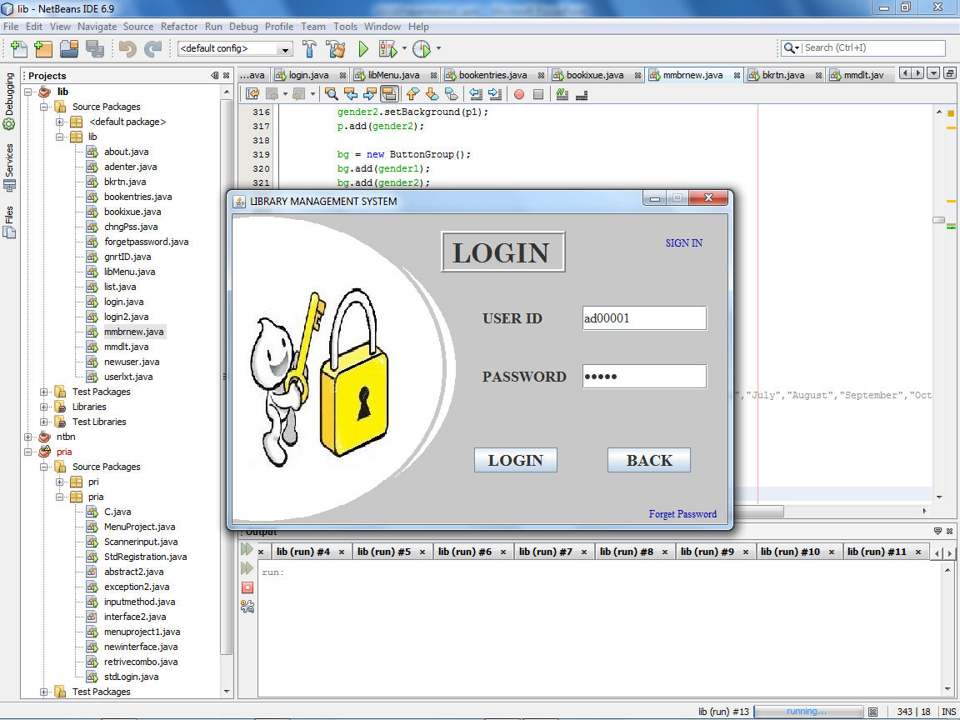
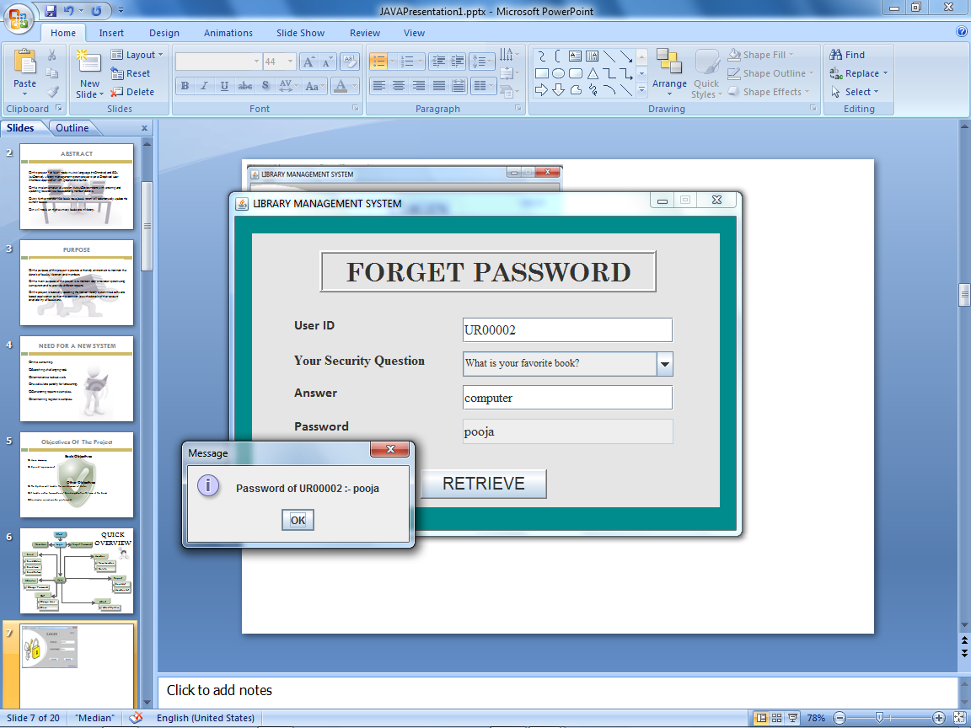
LOGIN PAGE
JLabel
FORGET PASSWORD PAGE

Slide 9
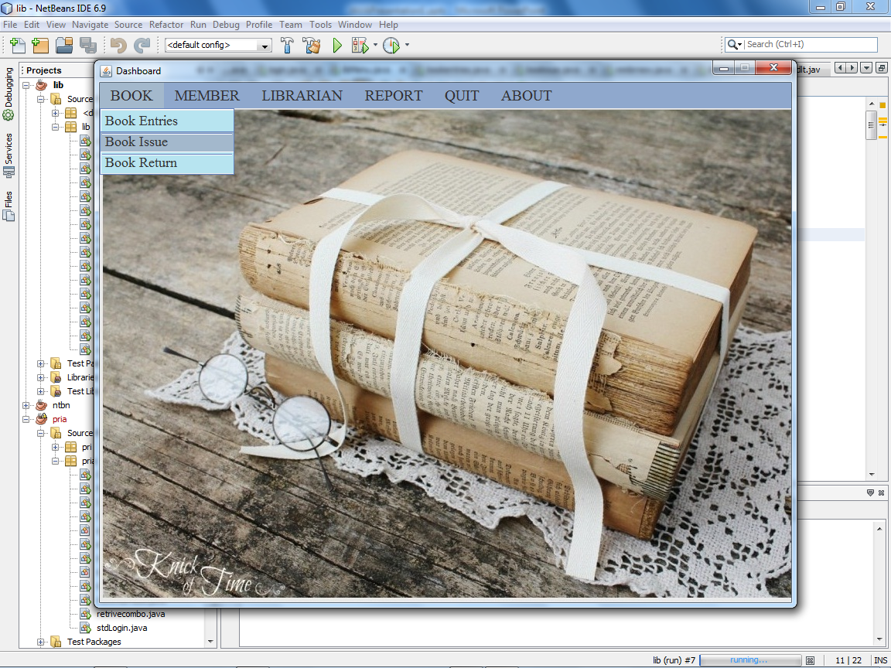
MENU PAGE
MenuBar
JMenu
JMenuItem

Slide 10
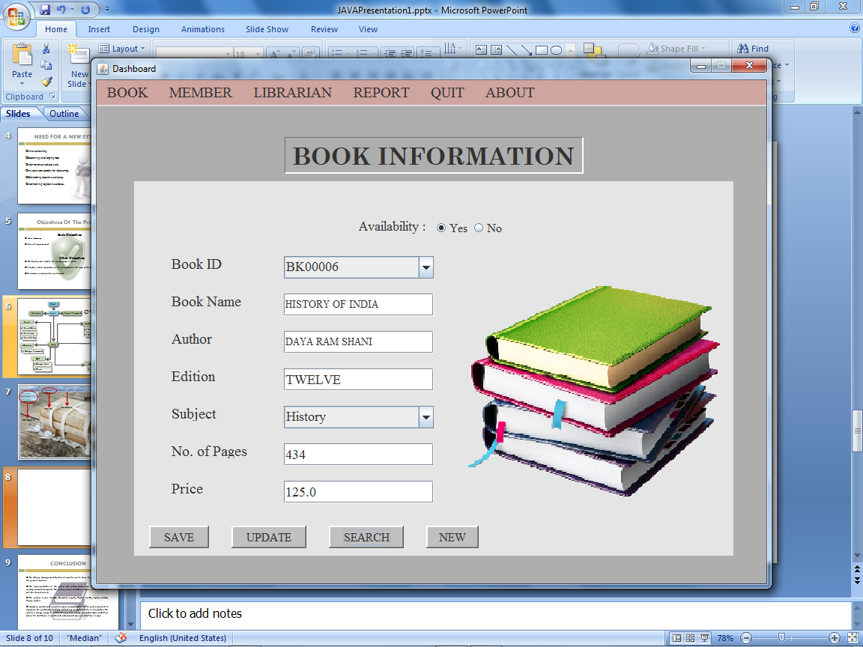
BOOK ENTRIES
JLabel
JRadioButton
JTextField
JComboBox
JButton

Slide 11
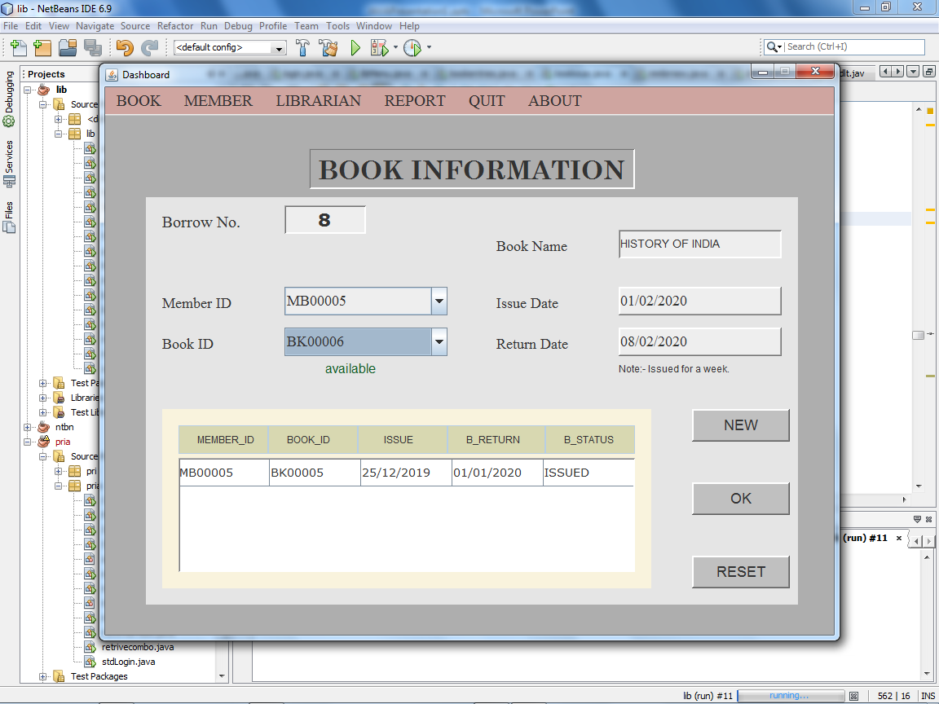
BOOK ISSUE
JTable

Slide 12
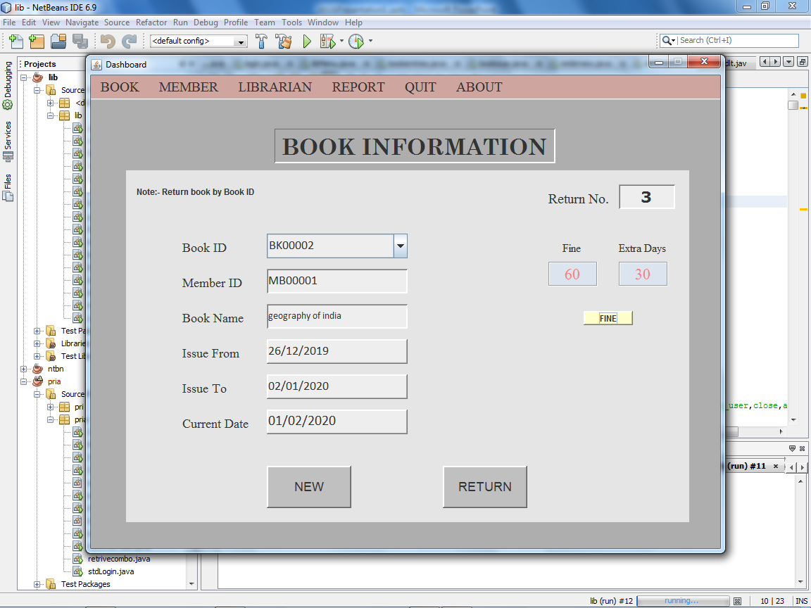
BOOK RETURN

Slide 13
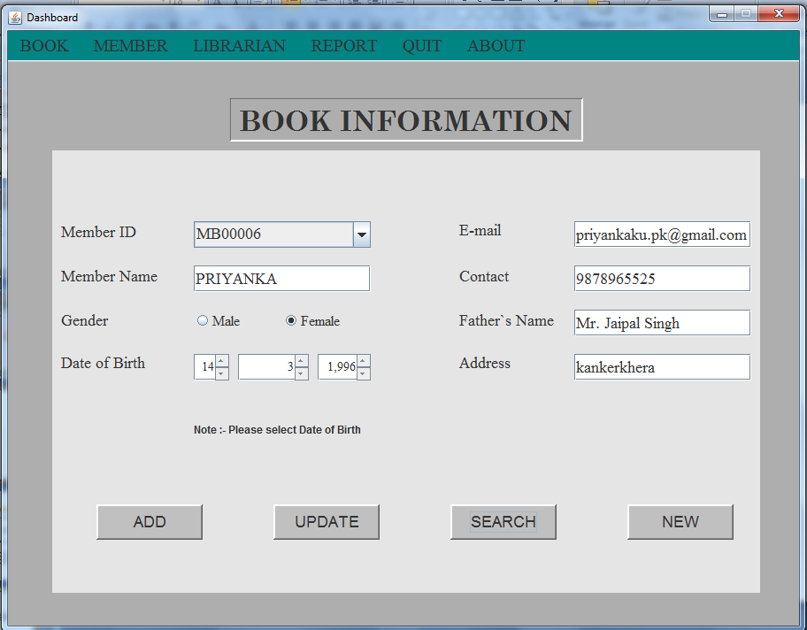
NEW MEMBER
JSpinner

Slide 14
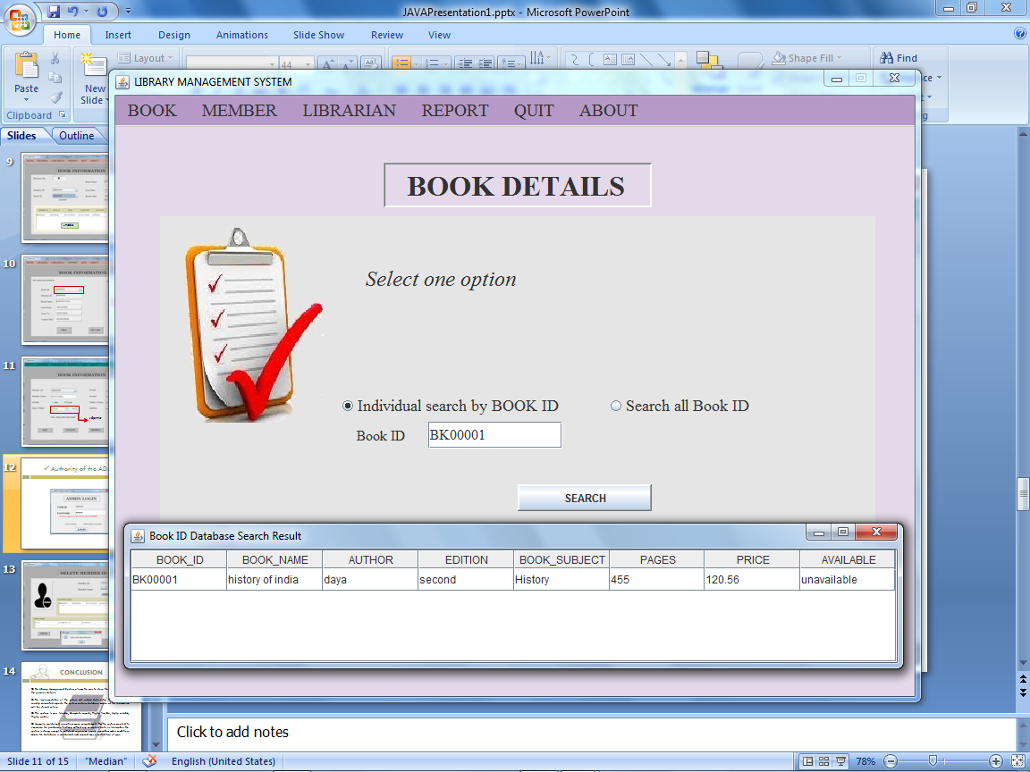

Slide 15
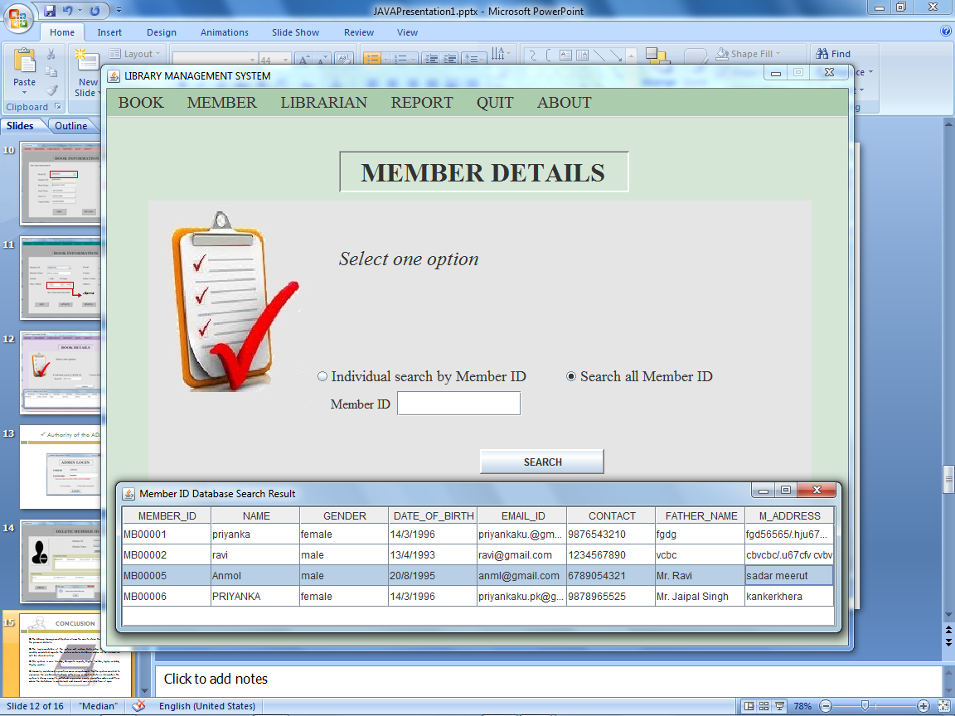

Slide 16
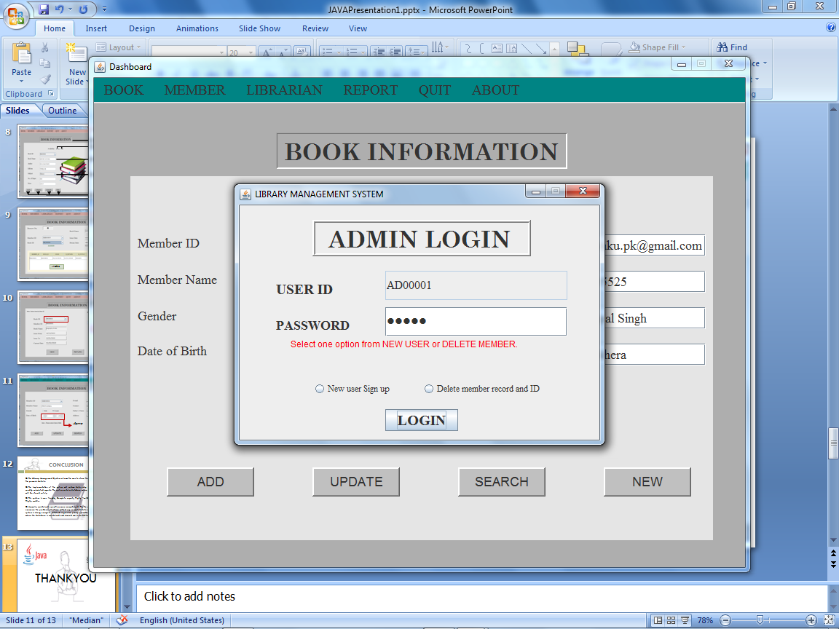
Authority of the ADMIN

Slide 17
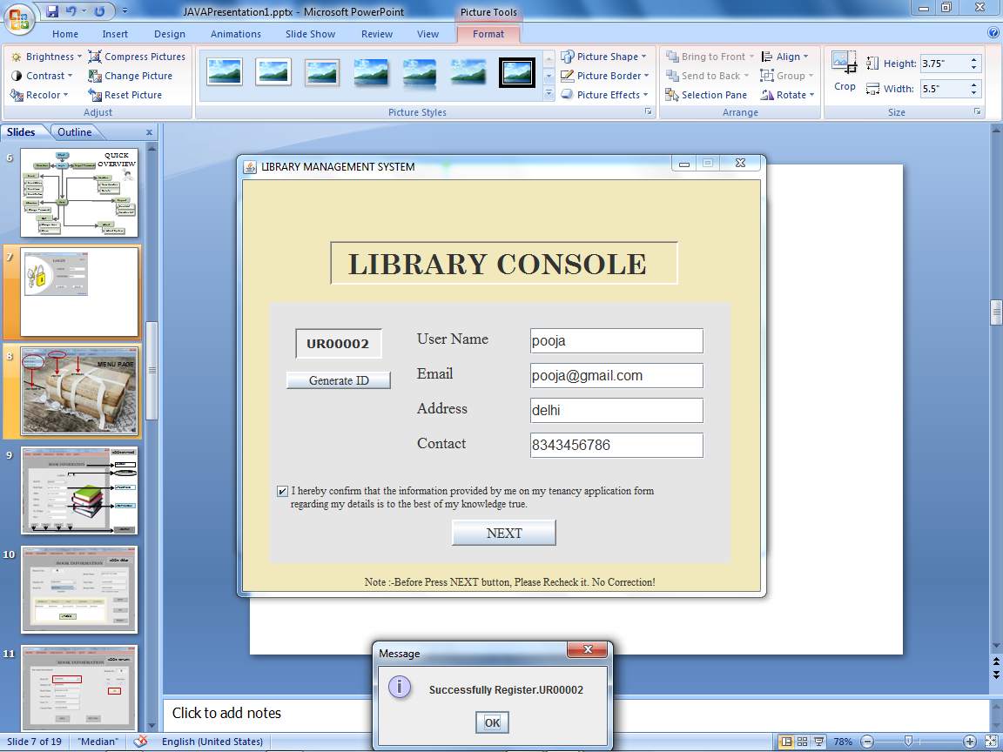
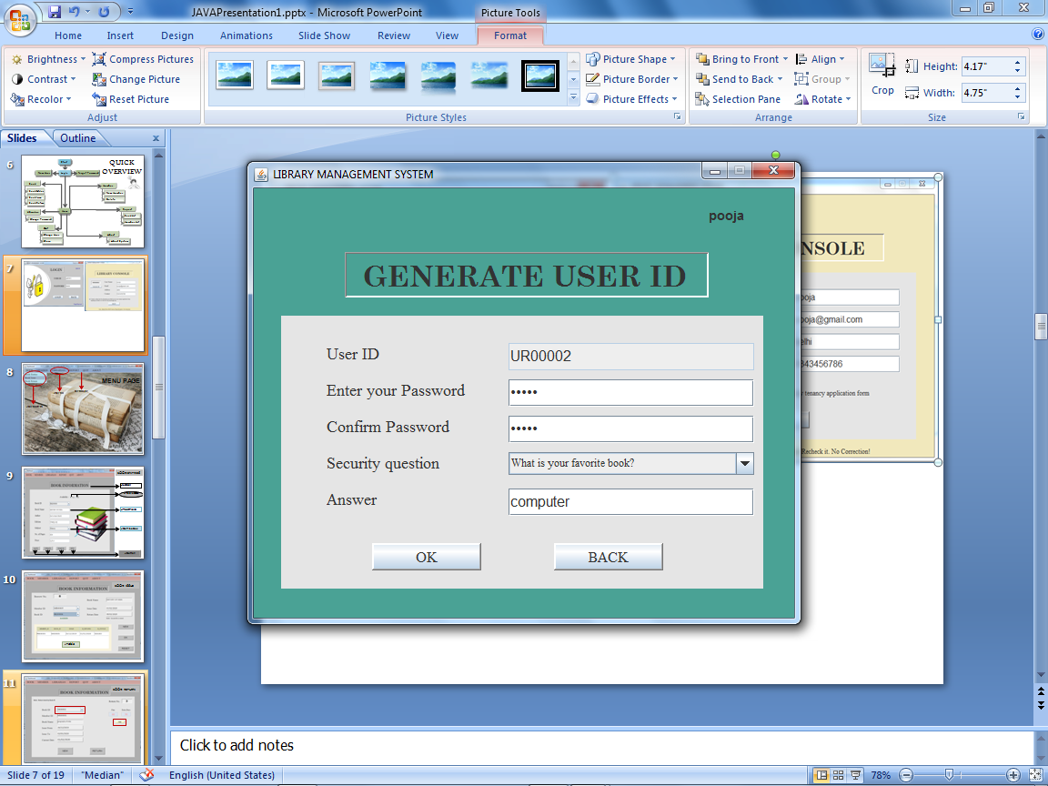

Slide 18
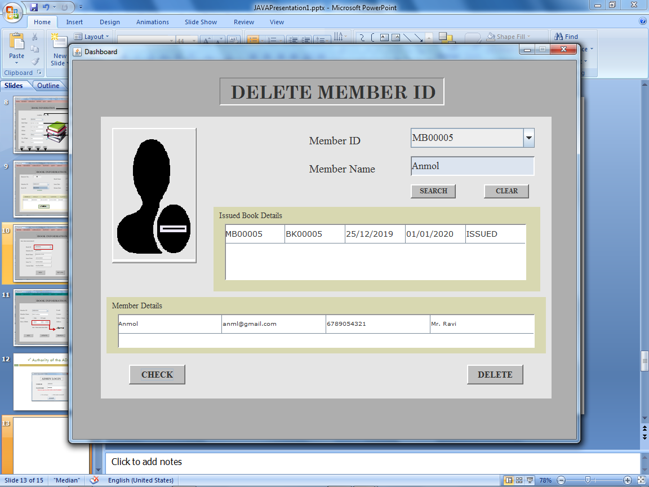
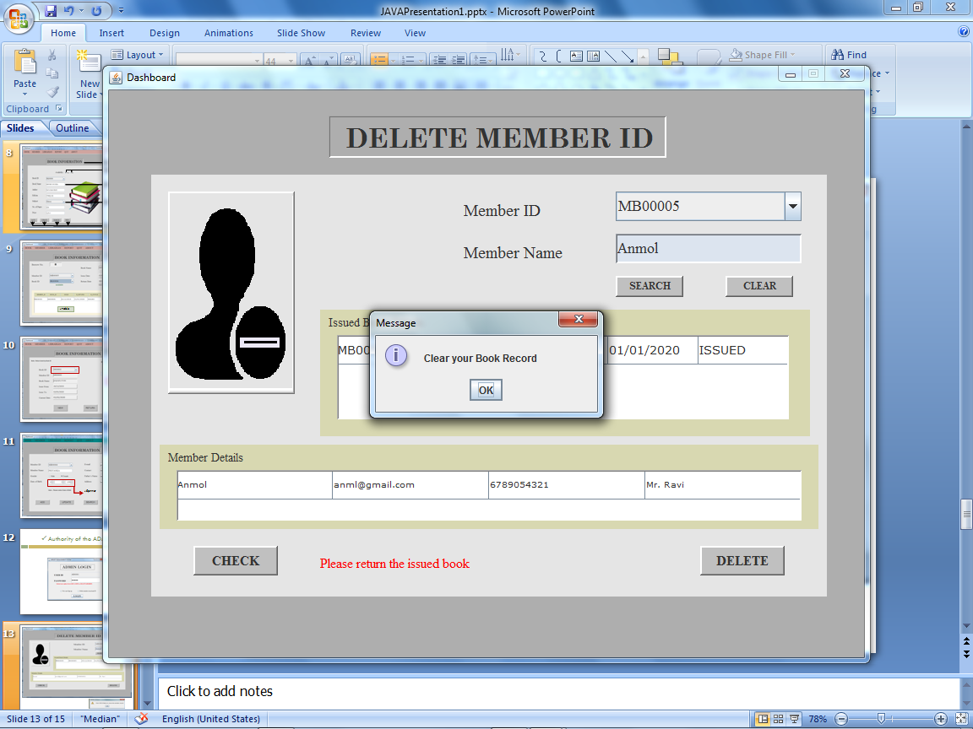

Slide 19

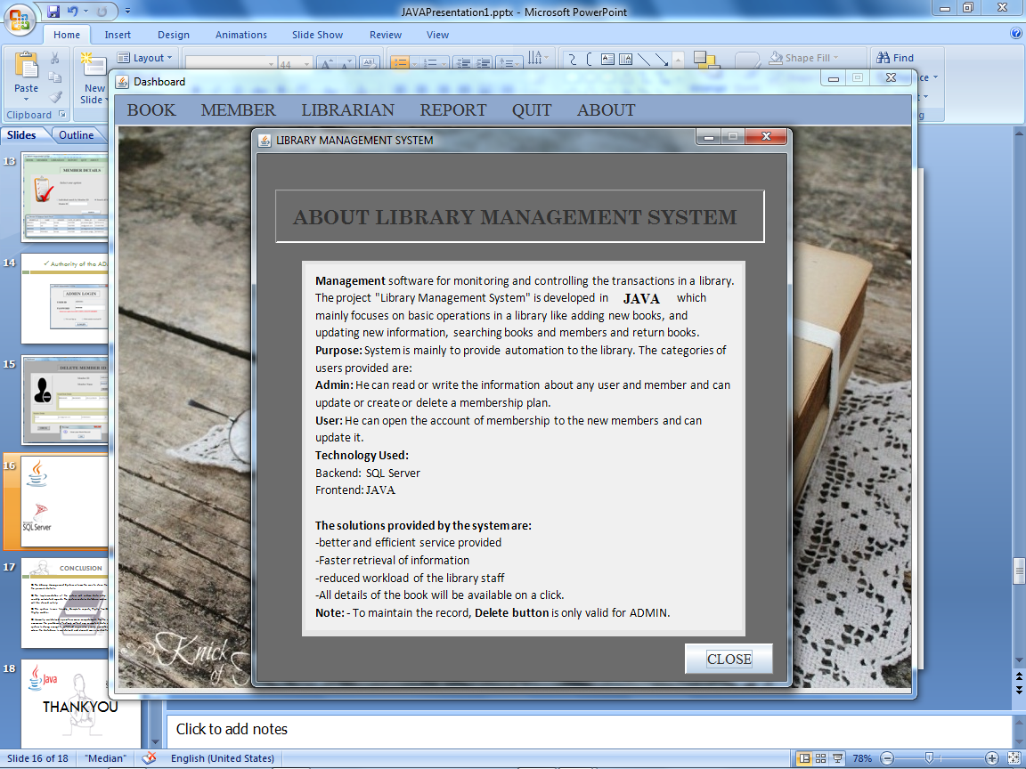


Slide 20


CONCLUSION
The Library Management System allows the user to store the book details and the person’s details.
The implementation of the system will reduce data entry time and provide readily calculated reports. The system contains database where all the information will be stored safely.
This system is user friendly, Complete reports, Highly flexible, highly reliable, Highly usable.
Manually maintained operations were computerized. Thus the system created to overcome the problems effectively without any corrupted data or information. The system is strong enough to withstand regressive yearly operations under conditions where the database is maintained and cleared over a certain time of span.

Slide 21


THANKYOU

